Slide 1
Caring for Adults with Dementia
Summary report By Research & Citizen Insight Elizabeth Roberts & Maura O’Malley

Slide 2
Acknowledgements
Thank you…
We would like to thank everyone who took the time to complete our survey and be part of this project. Your views are important and what you tell us will help to make things better for residents and care providers.
[To protect anonymity no identifiable data will be shared within this report.]

Slide 3
Introduction and key findings

Slide 4
Key Headlines
This is a summary of the key headlines based on what care providers stated in the survey, which indicates which areas should be a key focus moving forward.
60% of respondents told us that they are less likely to accept people living with dementia who have a history of distressed/challenging behaviours | There’s a need to receive an accurate assessment and clear information about residents from professionals and families. The biggest challenge for care homes is understanding how to manage distressed behaviours. More dementia-friendly homes would reduce distressed behaviour There is a need to improve support from external partners; such as MH services, GP’s, the NHS, Dementia Intensive Support Team (DIST) and dementia nurses. There was a need to improve support internally; appropriate funding, training to support staff recruitment and retention.
23% told us that they have given a notice to residents in the past 12 months. | More dementia-friendly homes would reduce distressed behaviour
76% told us that there are gaps in current service provision and they include the following: | There is a need to improve support from external partners; such as MH services, GP’s, the NHS, Dementia Intensive Support Team (DIST) and dementia nurses.

Slide 5
Overview
Essex County Council (ECC) wanted to understand experiences of care providers within a residential care setting looking after adults with Dementia and explore:
How current services could be improved.
How care providers in the residential care sector could be better supported in their role.
Care providers experiences in caring for adults with diagnosed and undiagnosed dementia.
The barriers and opportunities for how things could be made better for residents and care providers
“We are really pleased to hear that this survey is out there, as we can see the value in this”
Views were captured via an online survey, which was live from 13th February to 7th April, and was widely promoted through appropriate networks and channels including the Quality Improvement Team at ECC, market providers and Healthwatch Essex.
There were a total of 50 responses to the survey. 30 participants expressed an interest in being involved further with this research later in 2023. (See Annex A for more details on survey respondents)
We recognise the hard work and dedication of those who work within the care sector we want to stress that this survey is not an evaluation of service delivery.
This report presents key findings from this survey.
{Anonymous comment from an employee in the care sector}

Slide 6
Providing care to people living with dementia
The person being cared for
1. The Environment
2. Families
3. Care providers
4. Partners
The research identified 4 important factors that if working in partnership, contribute to providing the best care for residents.
These are the home environment, families, care providers and partners.
If one of these factors become disconnected, then challenges can arise for example:
Distressed behaviours from residents
The need to contact emergency services
Impact on staff capacity
Other residents safety and wellbeing could be affected.
GP
Hospital
Dementia services
Mental health services

Slide 7
Survey findings

Slide 8
Care providers are less able to accept potential residents who present with a history of challenging behaviours.
30 (60%) of respondents, told us that they are less likely to accept people living with dementia who have a history of distressed/challenging behaviours for example shouting, or physical aggression.
Reasons why included;
A lack of external support | Lack of number of staff | Lack of training and knowledge | Limited space or environmental conditions | Impact on other residents safety and wellbeing
The majority told us, in the past they were able to accept and accommodate, but due to a decline in resources and support, they are no longer able to do so.
Overall respondents highlighted the need to consider all residents’ safety and wellbeing, as well as the care providers safety and capacity to manage residents.
“In the past yes, we have been extremely willing to support people will additional needs, but due to changes and reduced support the answer is now no” [Survey respondent]

Slide 9
Some care providers still serve notices* to residents with challenging behaviours.
39 care home managers responded to the survey. 30 (77%) of managers told us that they have not given a notice, but 9 (23%) told us that they have given a notice to residents in the past 12 months. Providers suggested what could help decrease the number of notices being served in the future:
Clarity on what service they can contact and what support is available.
Advice on how to better support families.
Early interventions and a rapid diagnosis process needed enabling people to access the right support.
Placing residents in an appropriate care home that meets their needs.
Appropriate funding, so care homes can provide improved 1-to-1 support.
* Serving a notice to a residents, means that they are asking that resident to leave because of a valid reason.

Slide 10
76% of all survey respondents say there are gaps in current service provision
The main gaps highlighted are:
Not receiving accurate information about the adult.
Providers needing training to better understand dementia and distressed behaviours.
Improved external support from appropriate stakeholders.
Need for information on what makes a “Dementia-Friendly” environment in the homes.
Other gaps include the need for more staff to provide one-to-one support for residents, and early intervention for adults before transitioning from their own home into a care home.
Better two-way communication and information sharing between families and care providers when appropriate.

Slide 11
Notices could be more preventable if accurate information was shared.
“When assessing people the information needs to be given in full, often in my experience complex needs especially behaviours are often played down by family members and sometimes other professionals due to the fear of not being accepted. This is not helpful to the individual or the homes.”
[Survey respondent]
Only 8% of managers told us that they receive an accurate assessment and clear information about residents. Care home providers told us receiving inaccurate information about the adults prior to moving into the care home, makes caring for people more challenging.
It was noted that there is room for improvement in what information is collected and shared with care providers:
Greater transparency from sources providing the information about those who are going into the care home, which includes professionals and families.
Details shared on the type of dementia and how to help accommodate and meet individual needs.
Overall, receiving accurate information about the adult would help care home providers have suitable resources in place and better ensure a suitable placement. As well as result in less distressed behaviours from residents.

Slide 12
The biggest challenge is understanding how to manage distressed behaviours.
All care home providers told us the biggest challenge regarding caring for people living with dementia is the lack of support and advice on how to manage distressed/challenging behaviours.
Understanding reasons for distressed behaviour was the most important in enabling care home providers to support and provide appropriate care to people with dementia.
Overall, there is a clear need for care home providers to receive training to better understand reasons for distressed behaviour and how they can best manage this.
“Understanding how to deal with and relieve distressed behaviours and how to prevent them impacting negatively on others living in the home.”
Survey respondent

Slide 13
Staff expect immediate intervention for assessment and medication review from the support services.
42 (84%) respondents know of the dementia crisis/intensive support services and use these service once or twice a month (to read more see appendix). Respondents told us that they would expect the dementia crisis/intensive support service to deliver immediate intervention for assessment and medication review.
Other comments were having calls backs within 24-hours and the need for out of hours support.
“We usually ask for support once we have exhausted all other ideas etc, so we would help and support in a timely manner”
Survey respondent

Slide 14
More dementia-friendly homes would reduce distressed behaviour
Care home providers told us that they would like to receive advice, information and guidance on how to adapt to the different environmental needs of residents. Many respondents felt that if the care homes were better designed to be dementia-friendly, this could reduce distressed behaviour and allow care providers to work more efficiently. For instance, if care homes had:
Appropriate and accessible signage
Accessible layout/building
Personalised rooms
Using the 5 senses to aid support
“Environmental limitations are main reason for difficulties.”
Survey respondent

Slide 15
There is a need to improve support from external partners
“Support from wider agencies has declined to help us support people with additional needs i.e. social workers, Dementia services and ASC. Weekly IRN rates also do not cover costs for additional staff support. I have also found that additional needs are not always disclosed from placement team or the person completed ISP.”
[Survey respondent]
Care home providers told us that they have experienced a decline and lack of external support, from MH services, GP’s, the NHS, Dementia Intensive Support Team (DIST) and Dementia Nurses. Scenarios included:
long waiting times,
issues with dementia referrals and,
the need for support during out of hours.
There also needs to be emergency help for supporting challenging behaviour or moving someone to another facility. In cases of emergency many run out of options for support, which has resulted in having to contact the police.
Knowing what support is available and receiving improved signposting would improve efficiencies. While care providers state they need more support from statutory services which would help make working with people with dementia a more appealing career choice.

Slide 16
There was a need to improve support internally
Respondents mentioned the need for appropriate funding and more staff to enable care homes to also provide one to one support for residents.
Our findings told us that there is a challenge with staff recruitment and retention. This has an impact on the continuity of staff supporting the person living with dementia, and can have a negative effect on residents behaviours.
Care providers value and recognise the need for training and personal development and this includes building on their knowledge on dementia and how to manage distressed behaviours.
“Recruitment and continuity of staff with the skills or the ability and aptitude to develop the skills.”
Survey respondent

Slide 17
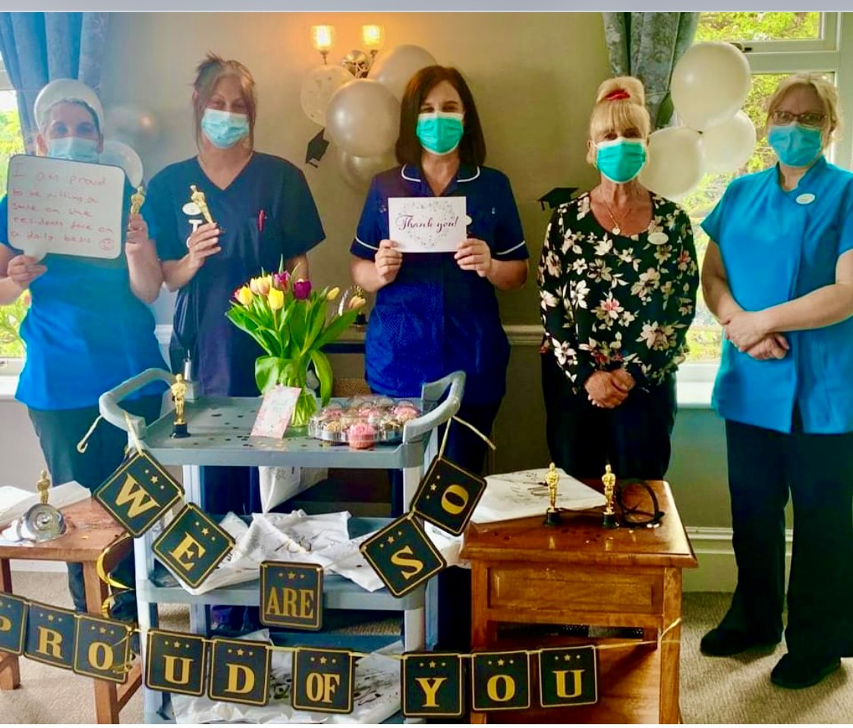
Other areas that would help provide the best possible care to adults with dementia
Other suggestions included:
More community involvement in providing care and support
More regular dementia-friendly activities
Taking an inclusive and person centred approach because dementia affects people differently. Spending time with the adult to understand their preferences and needs to help enhance their everyday life .
Affordable transport, so adults can access their local community and get to hospital appointments)

Slide 18
Learnings on what works well when caring for people with dementia
This is a summary of what care providers told us works well when caring for people living with dementia who have complex needs. These insights can be used to build upon and form a set of principles for providing successful care.
Having a safe and dementia friendly environment for residents to get about independently. | When staff have received training and have better understanding and patience.
Receiving external support, from the GP, dementia services, Mental Health services and families | When there are more staff, so care homes can provide one to one support. Staff retention; consistent staff working with the person.
Experience working with the person, so the care provider understands the persons needs and can provide a person-centred approach. | Having multidisciplinary team meetings for multidisciplinary approach
Good communication between care providers, and receiving accurate information about the person being cared for. | Early intervention and planning for transition before adults go into care
“We will show you the best of how it can be under the current circumstances.”
Survey respondent

Slide 19
In summary…

Slide 20
Conclusion
Essex’s care providers are dedicated to deliver excellent care to all of their residents. However, there are gaps in the current service, which if resolved, could better support our care provider, reduce distressed behaviour of residents, and reduce the number of served notices and/or people not being accepted into care homes. These include:
We have completed this piece of research which will be shared with commissioners within Adult Social Care for considerations in their programmes of work with care providers to co-create solutions as highlighted in this report.
Key findings;
Care home providers receiving training on how to manage distressed behaviours and better understand the different types of dementia. | Receiving appropriate support – this would reduce the number of calls to our police emergency services. | Receiving accurate information about the adult, to allow care providers to have the right resources in place. Reduce the number of notices served, and moving people into a more appropriate home. | Creating more dementia friendly environments, to reduce distressed behaviours.

Slide 21
Annex

Slide 22
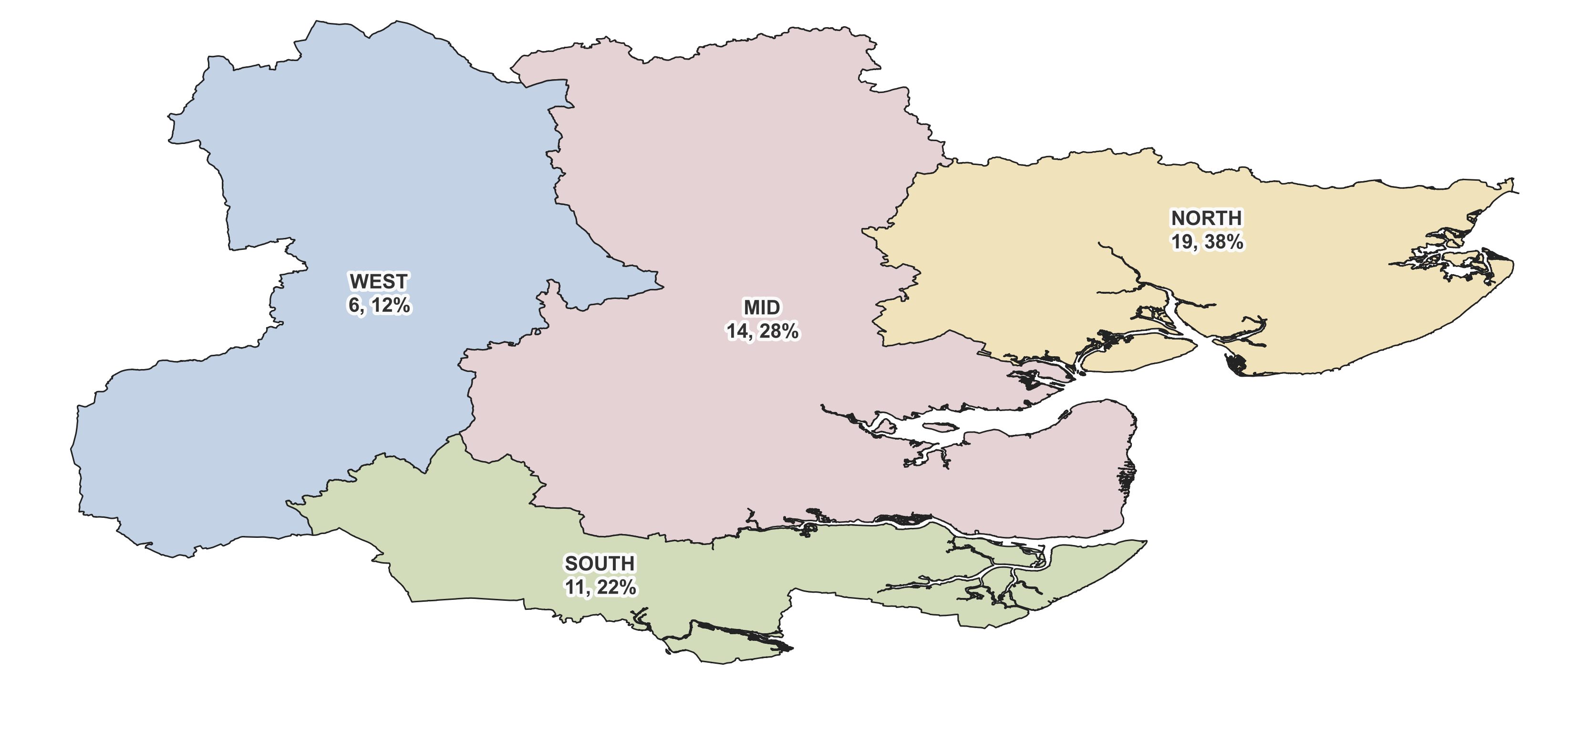
Survey respondents
Annexe A
Responses were received from care providers across all districts in the county, which reflected the proportion of providers in each district.
39 (78%) were from management
3 (6%) from care assistants
6 (12%) from ancillary services including catering, housekeeping & admin
27 (54%) are Dementia residential
7 (14%) are Dementia nursing
5 (10%) for Learning Disabilities with dual registrations including day and homecare services
The response rate from care assistants was relatively low, considerations could be given to future engage with this particular cohort to consolidate findings and/or unearth new insights.

Slide 23
This information is issued by: Essex County Council
Contact us: research@essex.gov.uk
Research & Citizen Insight Essex County Council County Hall, Chelmsford Essex, CM1 1QH
Essex_CC
facebook.com/essexcountycouncil
The information contained in this document can be translated, and/or made available in alternative formats, on request.
Published 06/2023

