Slide 1
Chelmsford Park and Ride Consultation and First Stage Tender Prices
Results
610 responses received

Slide 2
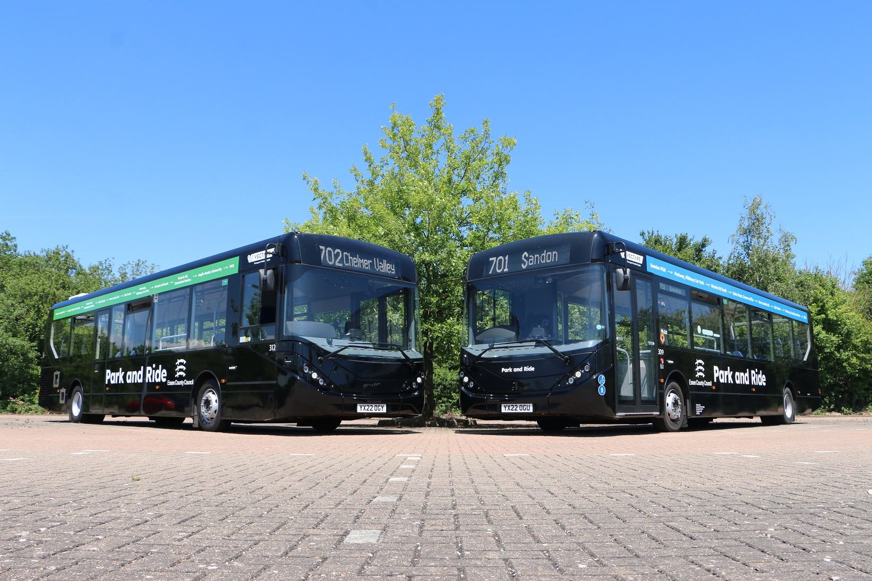
We asked the public to consult to help ECC make informed decisions on:
Shaping the timetable of bus services serving the Chelmer Valley site based around usage, including ceasing later evening journeys and the entire Saturday service.
Reducing on-site customer service support at both sites so that in-person help is only available at peak times.
The introduction of a £2 student ticket to sit between the £1 child fare and £3 adult day ticket
To change image:
Delete existing image and insert new by clicking on icon
or
Right-click, change picture
To resize or reposition image within placeholder:
Picture Format> Crop
Resize using white circles at corners
Move by click+hold on grey area of image then drag to position

Slide 3
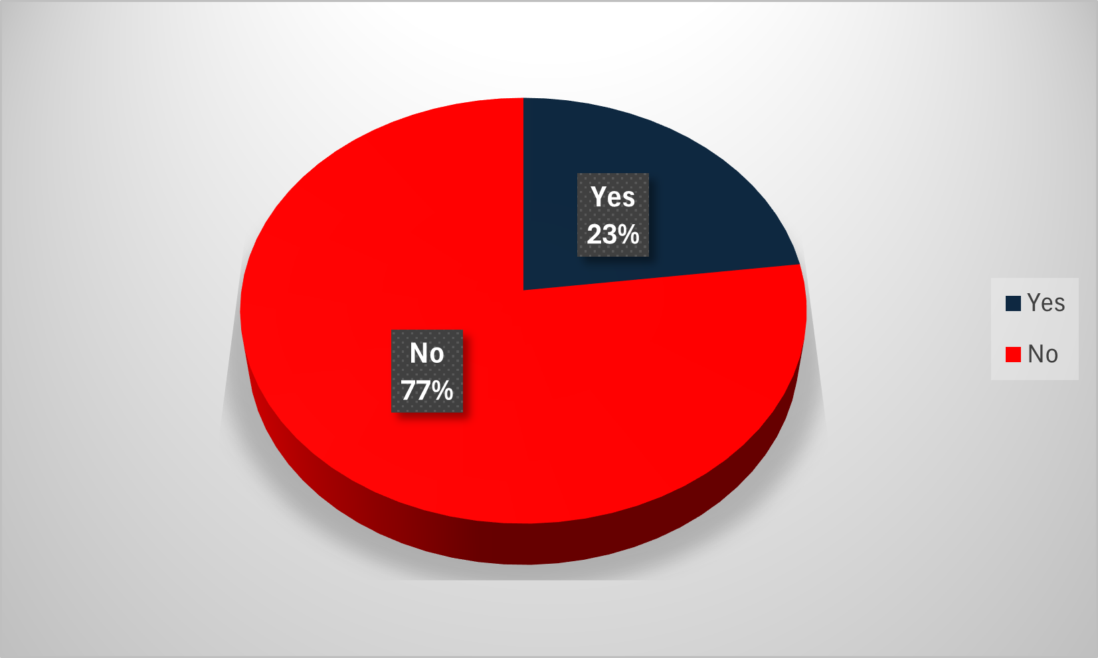
Proposal 1 - withdrawal of the Chelmer Valley services on Saturdays only. The average patronage using the Chelmer Valley bus service on Saturdays is 297 passengers compared to Sandon 782 passengers which is not being consulted on.
Do you support the proposed change to close Chelmer Valley Park & Ride on a Saturday?

Slide 4
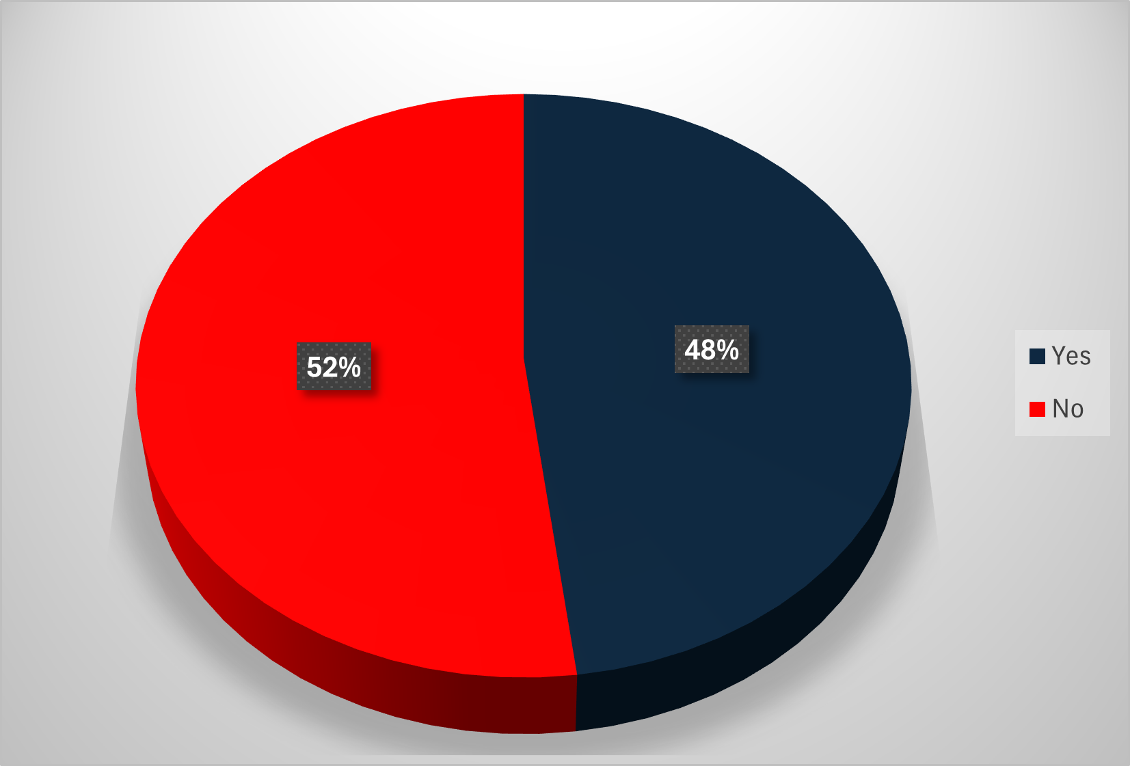
Proposal 2 - Withdrawal of late evening journeys on the Chelmer Valley bus service when it is less frequently used, though these trips are return trips and the inward journey may be made at peak times. The average patronage using the Chelmer Valley bus service after 19:30pm (4.3 passengers) 19:50 (2.6 passengers) 20:15 (2.2 passengers) 20:45 (1.2 passengers)
Do you support the proposed change to stop the service at 19:30pm at Chelmer Valley Park & Ride to align with Sandon?

Slide 5
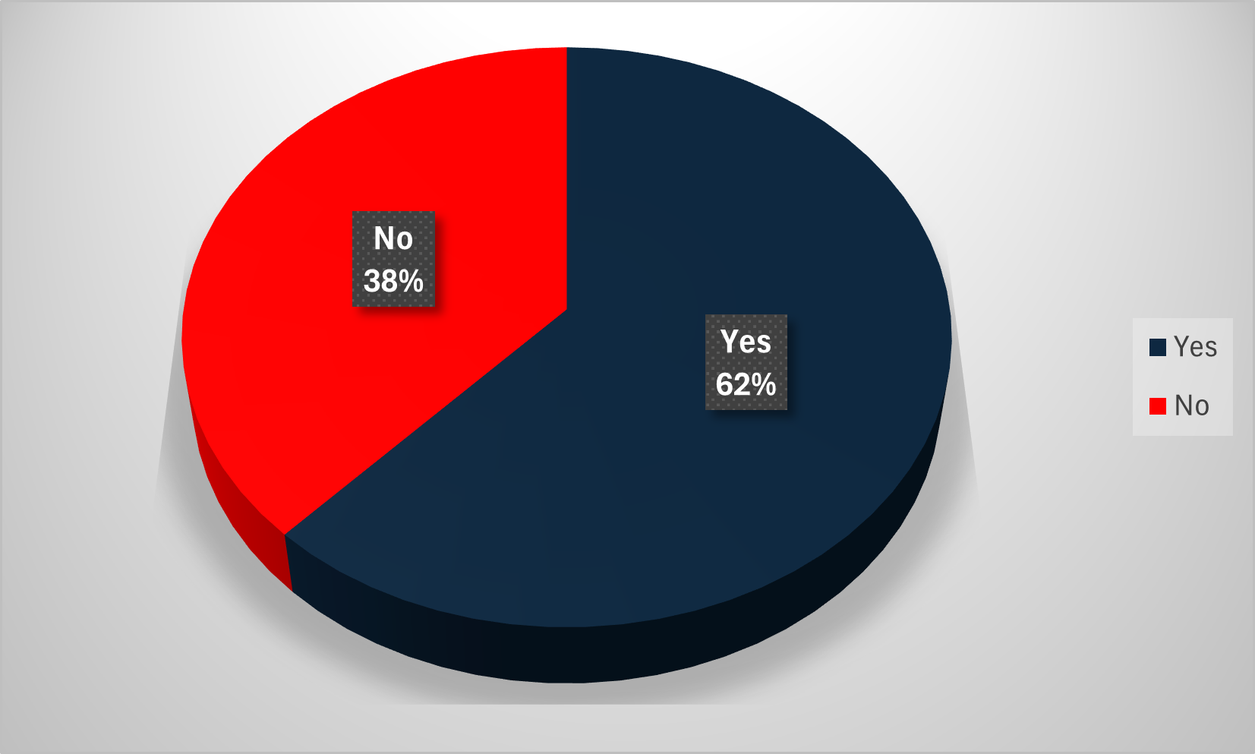
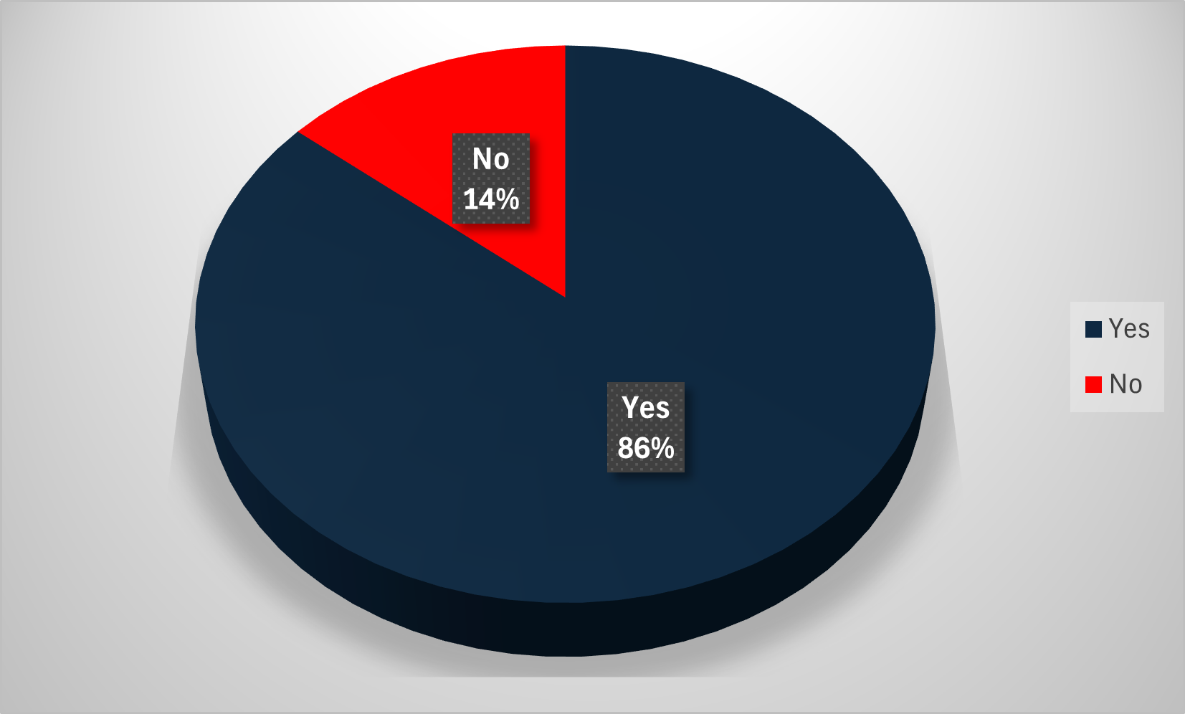
Proposal 3 - Introduce a student ticket priced at £2. The current child ticket is for passengers aged 5 to 18 inclusive. The proposal is to reduce the child ticket to age 16, which brings it in-line with other bus services and introduce a student ticket for those individuals who can show a student card. This will ensure child tickets are used by those within the appropriate age ran
Do your support Reducing the child ticket from 18 to 16?
Do you support the introduction of a new student ticket at £2?

Slide 6
Proposal 4 - The proposal is reducing on-site customer service support at both sites so that in-person help is only available at peak times.
Do you agree or disagree with a reduced presence of site staff and available only during peak times?

Slide 7


This information is issued by: Essex County Council
Contact us:
xxx@essex.gov.uk
xxx
xxx
Essex County Council
County Hall, Chelmsford
Essex, CM1 1QH
Essex_CC
facebook.com/essexcountycouncil
The information contained in this document can be translated, and/or made available in alternative formats, on request.
Published xxx

